Slide 1
Minor Industrial Metals
Robert Hendrickson, MD

Slide 2
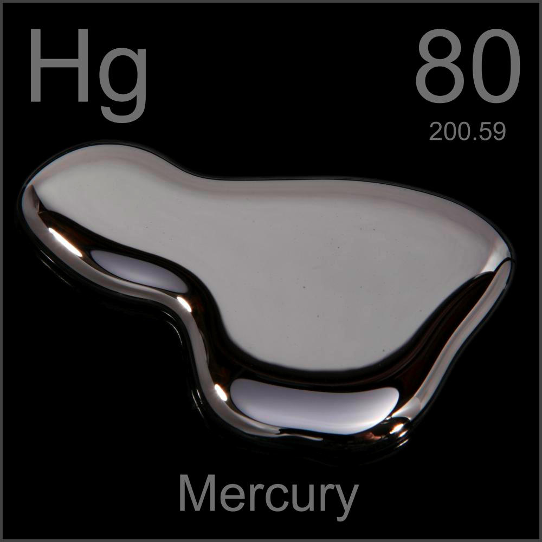
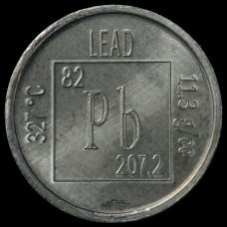
Minor industrial metals

Slide 3
Minor industrial metals
Aluminum
Beryllium
Cadmium
Chromium
Copper
Manganese
Nickel
Platinum/platinoids/palladium
Thallium
Zinc

Slide 4
Minor industrial metals
Aluminum
Beryllium
Cadmium
Chromium
Copper
Manganese
Nickel
Platinum/platinoids/palladium
Thallium
Zinc

Slide 5
Aluminum

Slide 6
Aluminum
Most abundant metal in earth’s crust
Found as ores (bauxite, gibbite, boehmite), alumina (aluminum oxide, Al2O3), or in gems (ruby, sapphire, turquoise).
Refinement:
Bauxite (high temp/pressure, caustic soda) -> alumina
Smelting:
Alumina –(electrolytic reduction in potroom) -> aluminum

Slide 7
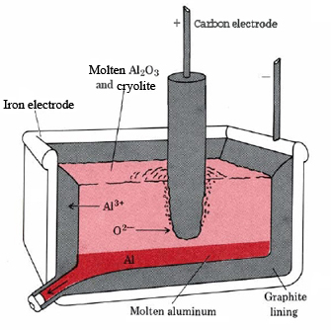
Aluminum

Slide 8
Aluminum potroom

Slide 9
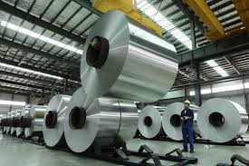
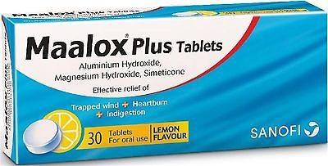
Aluminum
Uses:
Automobiles
Cookware, antiperspirants
Antacids
Alum solution (potassium[or ammonium] aluminum sulfate) – bladder irrigation (astringent)

Slide 10
Aluminum
Absorption: GI or inhalational
Distribution: bound to transferrin(90%) & citrate
Excreted unchanged in urine
Half-life: months to years (may be due to pulmonary deposition in workers)
Notes:
Transferrin – iron-binding glycoprotein

Slide 11
Aluminum
Workers at risk:
Aluminum refining & smelting
Welders
Workers involved in cutting/manipulating aluminum parts/plates

Slide 12
Aluminum
Acute toxicity: not occupational
Bladder irrigation with alum, oral intake of aluminum with CKD.
Encephalopathy, myoclonus, seizures
Tx: Deferoxamine
Prognosis: High mortality

Slide 13
Aluminum
Chronic Toxicity: Occupational
Potroom asthma:
Exposure to metal fumes
? Hydrogen fluoride vs. aluminum
May occur within months of initial exposure
Asthma-like: normal CXR, wheezing, SOB
May resolve with elimination of exposure

Slide 14
Aluminum
Chronic Toxicity: Occupational
Aluminosis (pulmonary fibrosis)
Pneumoconiosis, exposure to Al dust
Restrictive lung disease
CXR: increased pulmonary markings, irregular opacities, distortion of pleura/diaphragms.
Progressive – no recovery even with elimination of exposure

Slide 15
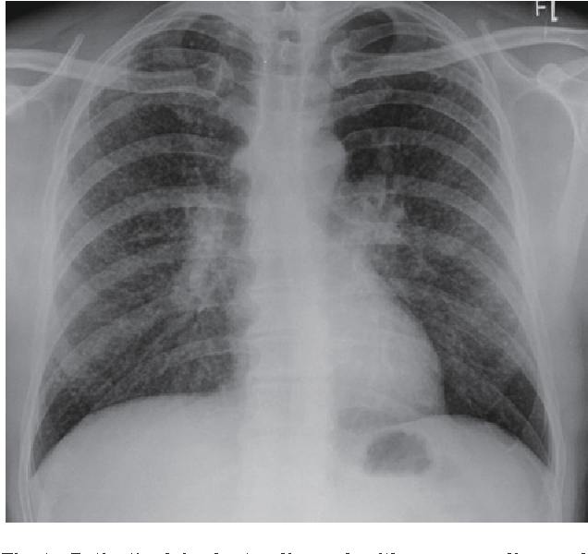
Aluminum

Slide 16
Aluminum
Chronic Toxicity: Multisystem toxicity
Described with large chronic aluminum intake with poor renal function:
3 workers –chronic Al metal powder
Aluminum contaminated dialysis solution ("dialysis dementia")
Illicit drugs cooked on aluminum
Chronic use of Al-containing phosphate binders

Slide 17
Aluminum
Chronic Toxicity: Multisystem toxicity
Signs/symptoms:
Encephalopathy
Dementia
Myoclonus
dysphasia, stuttering, mutism
Seizures
Microcytic anemia
Inhib of delta aminolevulinic acid dehydrogenase (like lead)
Osteomalacia
Al accumulates in osteoblasts and leads to poor mineralization

Slide 18
Aluminum
Treatment:
Removal of exposure
Deferoxamine(DFO) limits and reverses some encephalopathy, anemia, and osteomalacia
Not used for pulmonary disease w/o systemic signs
Acute toxicity: DFO 15mg/kg/d IV
Combined with HD 6-8 hours later, if needed
Chronic toxicity: DFO
National Kidney foundation guidelines
Initial 4 months of once weekly DFO infusion before HD
Then, regimen depends on blood [Al].

Slide 19
Aluminum
Biomonitoring
Urine Aluminum (<2.3 umol/g Cr)
Pulmonary function (restrictive function)
Prevention
Respiratory filter (P100)

Slide 20
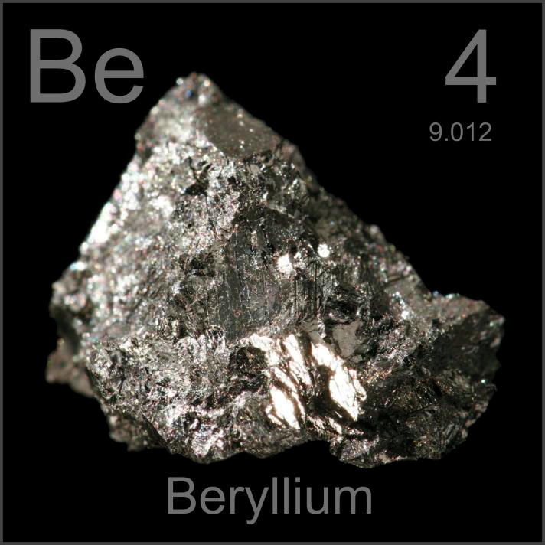
Beryllium

Slide 21
Beryllium
Light weight, high tensile strength, low coefficient of thermal expansion
Aerospace, nuclear weapons
Ceramics
Computer parts, electronics
Also:
Alloy for dental bridges
Copper berrylium – springs/tools used in environments with explosive hazards (e.g. mines, oil rigs) or cryogenic equipment

Slide 22
Beryllium
Exposure
Fumes (beryllium oxides)
Respirable dust (beryllium oxides, metal, salts, alloy)
Machinists – have highest rate of toxicity
Absorption
Inhalational
Excretion – urine

Slide 23
Beryllium
Toxicity
Acute high concentration exposure
Acute berrylium pneumonitis
Can be associated with mucosal irritation
CXR: peribronchial thickening, diffuse infiltrates
Tx: Corticosteroids
Prognosis:
May resolve over weeks to months
can become chronic
rare acute fatalities
Exposure well above the PEL

Slide 24
Beryllium
Toxicity – dermal
Beryllium salts
Contact dermatitis
Beryllium splinters embed in skin/wounds
Chronic skin ulceration
Wart-like granulomatous papules
Require debridement/excision

Slide 25
Beryllium
Mahmoud Elhusseiny Abolmagd, Occupational lung diseases –general principles and approaches and beryllosis review, available at: https://www.slideshare.net/1084843033/occupational-lung-diseases-general-principles-and-approaches-and-beryllosis-review

Slide 26
Beryllium
Toxicity – Chronic Beryllium Disease (CBD)
Inhalation of beryllium dust or fumes
Beryllium deposits in pulmonary interstitium & some translocate to hilar lymph nodes
Induce Type 2 MHC immune response

Slide 27
Beryllium
Toxicity – Chronic Beryllium Disease (CBD)
Symptoms/signs:
Insidious onset
May occur w/in 2 months of exposure up to 30 years (mean is 6-10y after exposure ceases)
Cough, CP, SOB, potential PAH, Right ventricular failure
Early sign: bilateral basal rales
Poor exercise tolerance-most sensitive
CXR:
nodular parenchymal densities
Hilar lymphadenopathy
Notes:
Poor exercise tolerance is the most sensitive question/test to detect early CBD

Slide 28
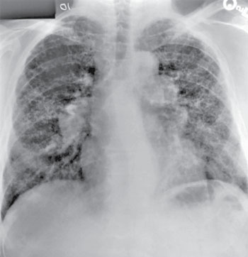
Beryllium

Slide 29
Beryllium
Pulmonary toxicity – mixed pattern:
Obstructive (1/3)
Restrictive (1/3)
Reduced diffusing capacity (DLCO) with normal lung volume and airflow (1/3)

Slide 30
Beryllium
Diagnosis:
CT scan more sensitive than CXR for detecting pulmonary disease
Beryllium lymphocyte proliferation test (BeLPT)
Blood or BAL
Positive only if lymphocytes react to beryllium
Very specific for Berylliosis (CBD)
BAL BeLPT can be used to differentiate sarcoidosis from chronic beryllium disease.

Slide 31
Beryllium
Prevention:
CBD can occur at concentrations below the PEL
~ 1-3% of all workers will develop beryllium sensitivity (without symptoms or signs)
Notes:
Exercise tolerance test is the most sensitive

Slide 32
Beryllium
Prevention:
Substitute safer materials
Engineering controls
Industrial hygiene practices
Workplace monitoring
Administrative controls (limit # of employees exposed)
Medical screening program
Notes:
Exercise tolerance test is the most sensitive

Slide 33
Beryllium
Prevention:
Monitoring – every 2 years:
BeLPT (10% of cases have negative BeLPT)
Exercise tolerance test
Chest xray
Pulmonary function testing
Diffusion capacity
Notes:
Exercise tolerance test is the most sensitive

Slide 34
Beryllium
Treatment for Chronic Beryllium Disease (CBD):
Lifelong corticosteroids – slow progression of pulmonary disease
Indications: severe symptoms, abnormal radiography, abnormal pulmonary test/diffusion test
Notes:
Prednisone 50mg qd for 6 months, then decrease to least effective dose.

Slide 35
Cadmium
Notes:
Prednisone 50mg qd for 6 months, then decrease to least effective dose.

Slide 36
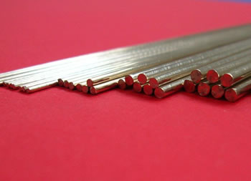
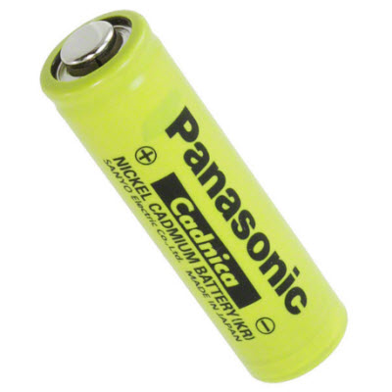
Cadmium
Found in zinc ores
Cadmium sulfide or oxide
Uses:
Solder & brazing rods
Nickel cadmium batteries
Pigment (glass manufacture)
Neutron absorber in nuclear reactors
Veterinary antihelminthic
Notes:
Prednisone 50mg qd for 6 months, then decrease to least effective dose.

Slide 37
Cadmium
Workers at risk:
Welders
Hobbyists (tend to have less PPE & engineering controls)
Notes:
Prednisone 50mg qd for 6 months, then decrease to least effective dose.

Slide 38
Cadmium
Absorption: inhalational
Bound to alpha2-microglobulin & albumin
Concentrates in liver & kidney
Bound to metallothionein (Cd-MT)
Sequesters Cd, decreasing toxicity
Cd-MT is filtered in urine, then reabsorbed in proximal tubule, leading to renal toxicity
Half-life: > 10 years
Notes:
Prednisone 50mg qd for 6 months, then decrease to least effective dose.

Slide 39
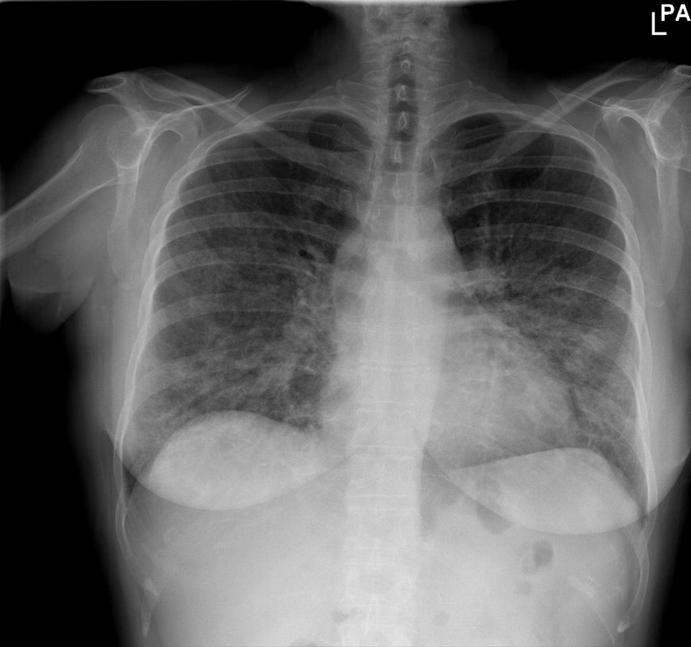
Cadmium
Acute inhalational toxicity:
6-12 hours after exposure
Fever, cough (looks initially like metal fume fever)
ARDS progresses over 3 days
Treatment:
Corticosteroids
Prognosis:
Some recover lung function
Chronic restrictive lung disease
Fibrosis
Notes:
Prednisone 50mg qd for 6 months, then decrease to least effective dose.

Slide 40
Cadmium
Acute oral ingestion of cadmium compounds:
Severe irritant injury to upper GI tract
Multi-organ failure
Hypotension
Treatment:
Gastric lavage (NGT, usually powder)
DMSA (succimer)
Notes:
Prednisone 50mg qd for 6 months, then decrease to least effective dose.

Slide 41
Cadmium
Chronic exposure:
Kidney dysfunction:
Initial proteinuria (beta microglobulin), then procedes to glomerular dysfunction and CKD
Pulmonary effects:
Conflicting studies: no effect, restrictive, obstructive
Osteomalacia
Itai-Itai disease associated with oral cadmium, primarily in post-menopausal women, not seen often in workers
Cancer
Some association with lung cancer (though As may be the cause)
IARC 1 "known human carcinogen"
Notes:
Prednisone 50mg qd for 6 months, then decrease to least effective dose.

Slide 42
Cadmium
Prevention:
Ventilation
Respiratory protection
Medical monitoring:
Initial UCd, beta2 microglobulin
At least annual
Removal from duty:
Urine beta 2 microglobulin > 750 mcg/g Cr
& Urine cadmium > 3 mcg/g Cr
Urine cadmium > 7 mcg/g Cr
Blood cadmium > 10 mcg/L
Notes:
Proteinuria can occur with Urine cadmium as low as 5 mcg/g Cr.
95%ile of US citizens is 2 mcg/g Cr

Slide 43
Cadmium
Treatment:
Removal from exposure
Chelation is not effective for chronic toxicity
Most Cd is chelated to metallothionien
Proteinuria & kidney dysfunction are not necessarily reversible
Notes:
Prednisone 50mg qd for 6 months, then decrease to least effective dose.

Slide 44
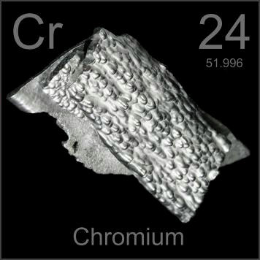
Chromium
Notes:
Prednisone 50mg qd for 6 months, then decrease to least effective dose.

Slide 45
Chromium
Found as chromite (FeCr2O4)
Oxidation states –2 to +6, but primarily
Cr3+ (trivalent chromium)
Cr6+ (hexavalent chromium)
Common use:
Stainless steel (chromium, nickel, iron)
"hard chrome"-plating for machine parts
Armor plating/safes
Notes:
Prednisone 50mg qd for 6 months, then decrease to least effective dose.

Slide 46
Chromium
Essential element
Facilitates insulin binding
Metabolism of glucose and fats
Reduction of Cr6+ to Cr3+ occurs with extraction of electrons from proteins, lipids, DNA, etc (oxidizing potential)
Notes:
Prednisone 50mg qd for 6 months, then decrease to least effective dose.

Slide 47
Chromium
Common industrial sources:
Welding stainless steel
Ferrochrome pigment manufacturing & use
Leather tanning
Chrome plating & chromate production
Environmental sources:
Coal power plants
Wood treated with CCA (copper, chrome, arsenate)
Notes:
CCA was voluntarily pulled from the market in 2003

Slide 48
Chromium
Absorption:
Inhalational – major route in industrial settings
GI – very poor, hexavalent > trivalent
Cr6+ mostly converted to Cr3+ once absorbed
Excreted as Cr3+ in urine (80%)
Half-life triphasic
7h, 15-30d, 3y
Notes:
CCA was voluntarily pulled from the market in 2003

Slide 49
Chromium
Acute toxicity:
Ingestion of Cr6+
GI hemorrhage
Hemolysis / DIC
ATN / AKI
Hyperlactatemia
Hyperkalemia
ARDS – up to 3 days after exposure
Notes:
CCA was voluntarily pulled from the market in 2003

Slide 50
Chromium
Chronic toxicity – inhalational industrial
Occupational asthma
Pneumoconiosis
Lung cancer – small-cell
Latency 13-30 years (but as low as 2 years)
Nasal septal perforation
Aminotransferase elevation
Notes:
CCA was voluntarily pulled from the market in 2003

Slide 51
Chromium
Chronic toxicity – dermal
Contact dermatitis:
Type 4 hypersensitivity reactions
Cement workers (wet cement)
Handling automobile parts
Locksmiths
Notes:
CCA was voluntarily pulled from the market in 2003

Slide 52
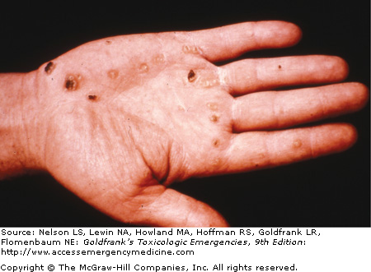
Chromium
Chronic toxicity – dermal
"Blackjack disease" - hand contact dermatitis
"Chrome holes" - painless ulcers of the skin or nasal septum
Notes:
CCA was voluntarily pulled from the market in 2003

Slide 53
Chromium
Diagnosis:
Speciation of Cr3+ and Cr6+ is difficult
No commercially available chromium-free needles
Cigarette smoke contains chromium
Blood: may confirm recent exposure (~1d)
Urine: 24 hour collection in acid-washed metal-free container – reflects last 1-2 day exposure
Diurnal variation
Notes:
CCA was voluntarily pulled from the market in 2003

Slide 54
Chromium
Treatment:
N-Acetylcysteine
Increases renal excretion of chromium in rats
No human data
No chelators are effective
HD is not effective
Notes:
CCA was voluntarily pulled from the market in 2003

Slide 55
Chromium
Prevention:
PPE
Engineering controls
Biomonitoring
Urine chromium reflects recent exposure, so is best used in an investigation, but can be used as a screening tool for high risk occupations
Notes:
CCA was voluntarily pulled from the market in 2003

Slide 56
Questions and discussion…

